Slide 1

Literature Classification and Its Text Summarization
Presented By:
Laxmi Yadav
Bryan Dilone
Harsha Vardhan Kuruva

Slide 2
Introduction
Overall, this project can help us gain insights into the patterns and trends in COVID-19 research
It provide a valuable resource for healthcare professionals and researchers who need to stay up-to-date on the latest developments in the field.

Slide 3
Why this project?
Relevance
By working on this project, researchers and developers can contribute to advancing the state of the art in NLP and potentially create tools that can be useful in various fields such as journalism, academia, and publishing.
Complexity
These tasks involve processing large amounts of unstructured text data and extracting meaningful information from it.
Impact
The ability to accurately classify and summarize literature can have a significant impact on various fields

Slide 4
Hypothesis
Is it possible to obtain a summary of the article while ensuring that no important information is left out?
Can grouping research articles that are similar through clustering make it easier to find related publications?

Slide 5
About the Data
●https://www.kaggle.com/datasets/allen-institute-for-ai/CORD-19-research-challenge
COVID-19 Open Research Dataset Challenge (CORD-19)
(nearly 1,000,000 scholarly works about COVID-19, SARS-CoV-2, and associated coronaviruses, including over 400,000 in full text)
Size= 20GB
The files in each version are:
Change log
Cord_19_embeddings.tar.gz
Document_parses.tar.gz:
Metadata.csv

Slide 6
Data Ingestion
Metadata.csv file contains values corresponding to full text JSON files
This JSON files contain, full text of article, title, author, abstract, etc.
I created a subset file with this articles in ArticlesText1000.csv
Articles will be the unit of analysis here.

Slide 7

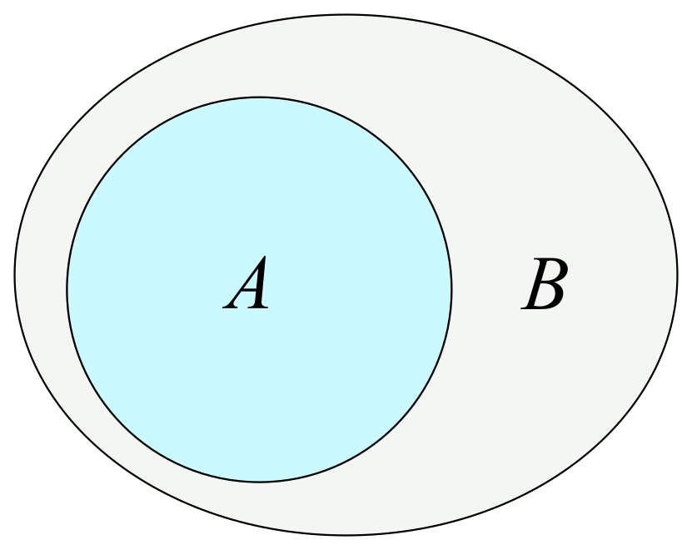

Data Features
Original dataset consists of nearly 1,000,000 work articles and its size is 20 GB
The subset dataset consists of 1000 articles and its size is around 30 MB

Slide 8
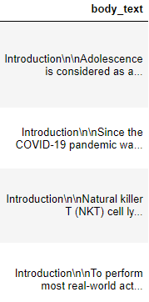

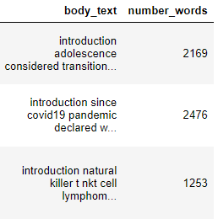
Initial Data Cleaning and Preprocessing
Initiated the data cleaning process by removing stop words (“a,the,is,are”), punctuation, and making the text lowercase.
Before
After
Results
Next step was to identify the number of words presented within each document.

Slide 9
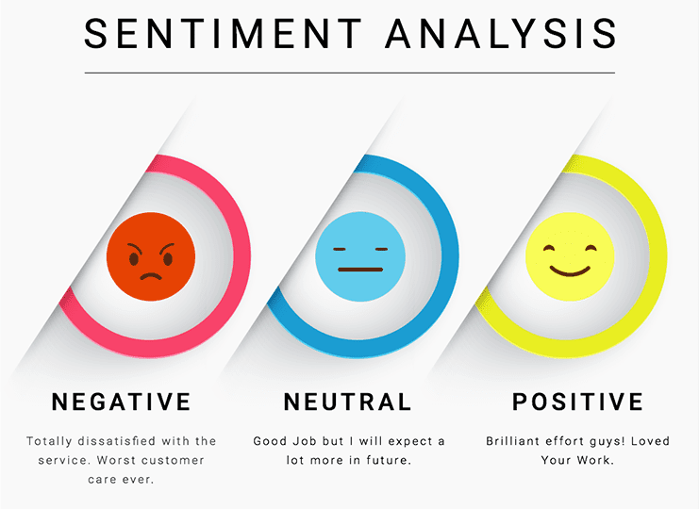
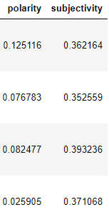
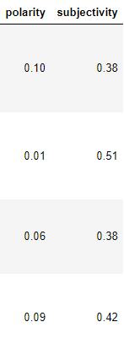
Initial Data Cleaning and Preprocessing cont.
Onto the Data Preprocessing step, we’ve implemented the technique Sentiment Analysis. This technique is used in two different ways, to determine whether the data is positive, negative, or neutral (Polarity), and determine whether a sentence expressed an opinion or not (Subjectivity).
Before
After
The next couple of slides would display the graphed outcomes of the Data Preprocessing step.

Slide 10
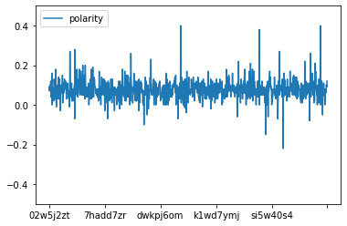
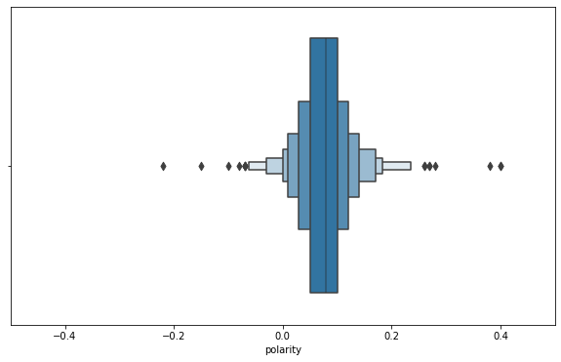
Sentiment Analysis
Polarity is used to determine if the text expresses a positive, negative, or neutral sentiment.
Polarity lies in the range of [-1,1] where 1 means a positive statement and -1 means a negative statement.
According to these graphs, the polarity from the articles states the following: 951 entries are greater than zero, 25 entries are less than zero, and only 24 entries are equal to zero.

Slide 11
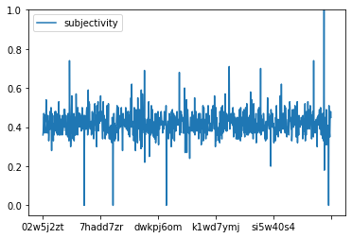
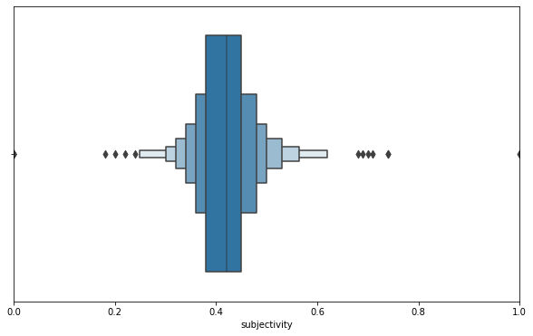
Sentiment Analysis cont.
Subjectivity is used for individual sentences to determine whether a sentence expressed an opinion or not.
Subjectivity is also a float that lies in the range of [0,1] where when it is close to 0, the sentence is more about facts. When it is close to 1, the sentence comes close to be an opinion.
According to these graphs, the subjectivity from the articles state the following: 996 entries are greater than zero, 0 entries are less than zero, and only 4 entries are equal to zero.

Slide 12
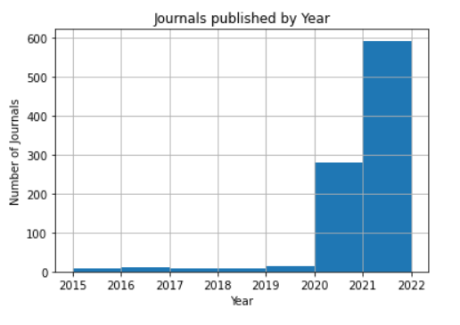
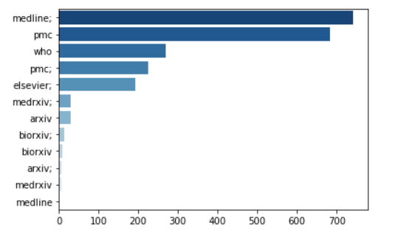
EDA
The first plot shows in which year most of the articles were published
This Graph shows from which organization most of the articles were published from

Slide 13
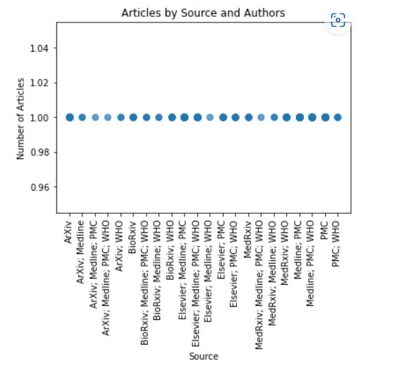
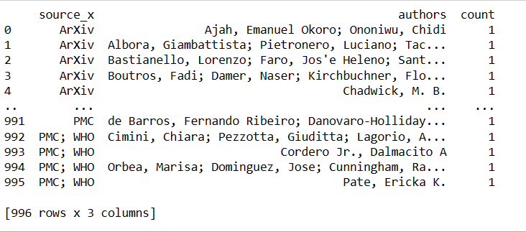
The below plot shows that combination of authors with source organization have published more articles or just single one.

Slide 14
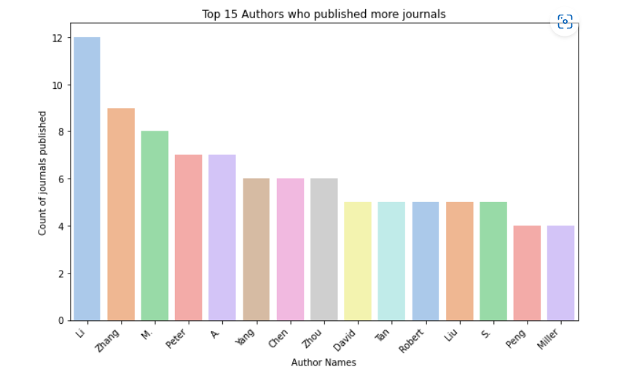
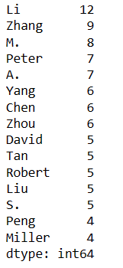
Top 15 Authors who have published more number of articles

Slide 15
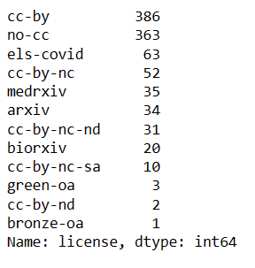
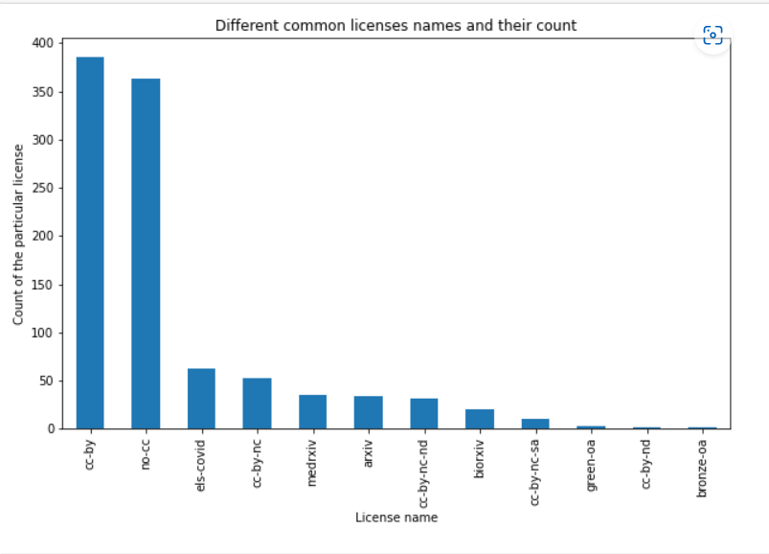
Checking whether the same combination of authors for a journal have different licenses as well

Slide 16
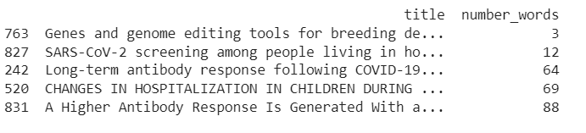
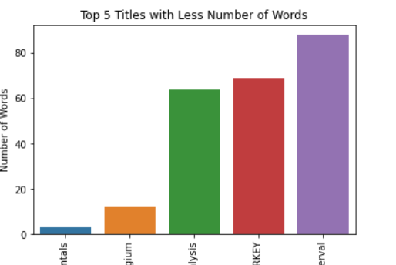
The below one shows the articles which contains the lowest number of words

Slide 17
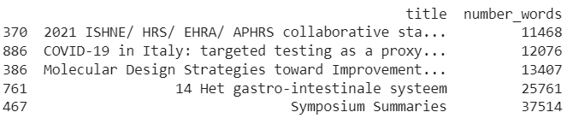
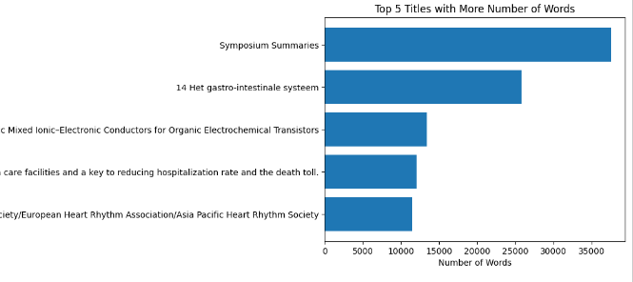
The following graph shows the articles which contains the highest number of words

Slide 18

The Most common words in the data

Slide 19

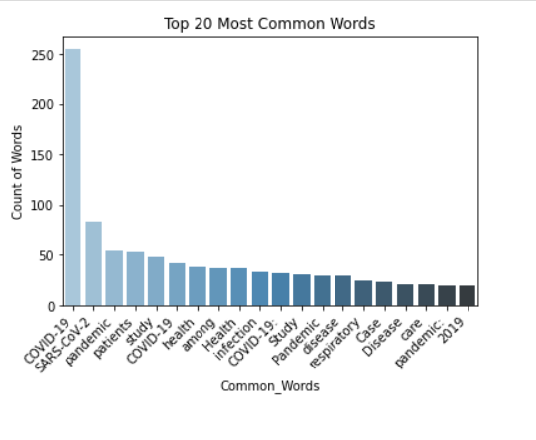
The top 15 most used common words

Slide 20
Clustering & Modeling
Literature classification
Implementing Kmeans
Text Summarization
Using T5 model for summarization

Slide 21
Literature Classification
It is challenging for medical practitioners to stay up to date on new information regarding the virus.
Can grouping research articles that are similar through clustering make it easier to find related publications?
The collection of literature can be represented as a scatter plot utilizing clustering for labeling and dimensionality reduction for display.
Publications with a remarkably similar topic will have the same label and be placed close to one another on this plot.

Slide 22
Approach
Randomly choosing a subset of dataset with 1000 articles
Data Pre-processing
Turn each documents into a feature vector using Tf-IDF
Apply PCA
Apply K mean clustering to label each clustering
Dimensionality Reduction using t-SNE

Slide 23
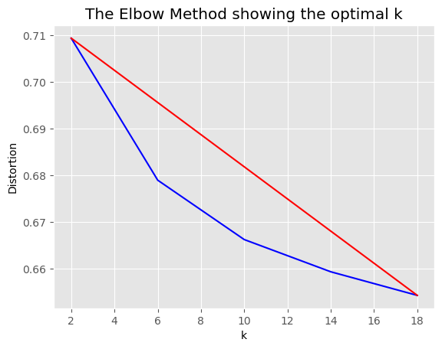
K-means Clustering
We will analyze the distortion at various k values in order to get the ideal k value for k mean

Slide 24
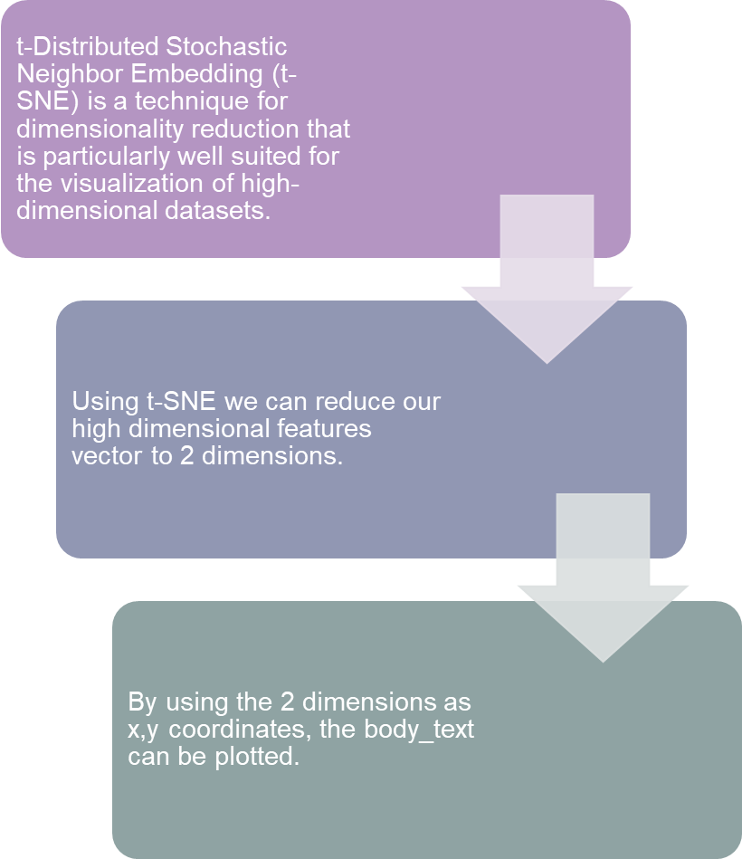
Dimensionality Reduction with t-SNE

Slide 25
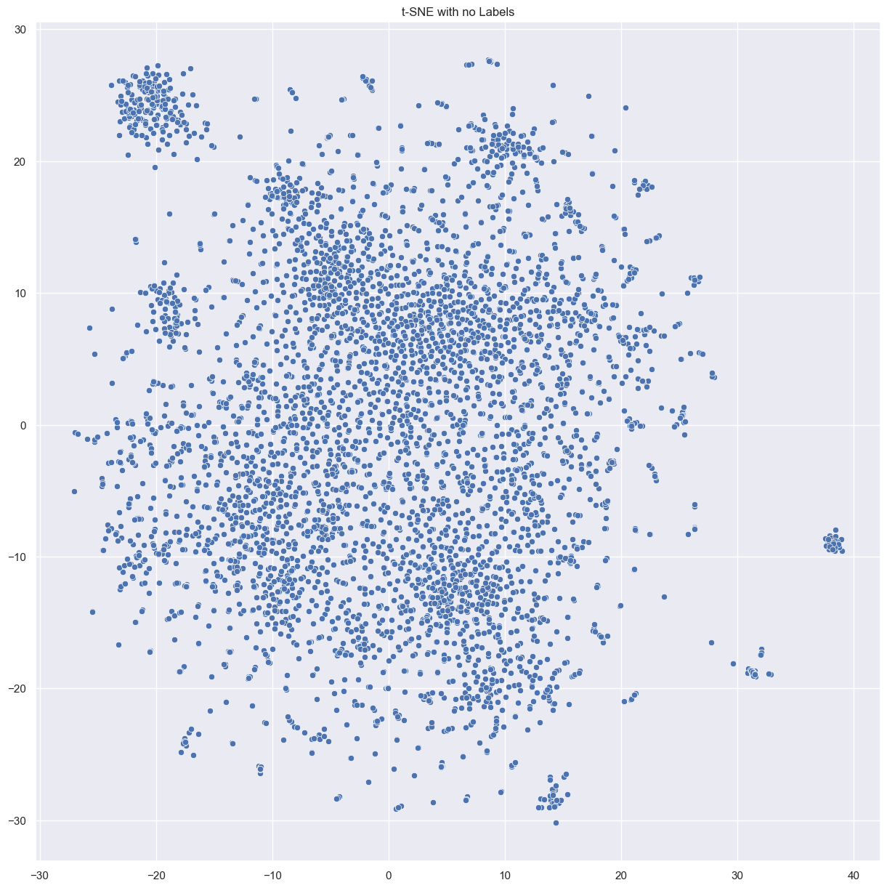
It is more difficult to distinguish many examples closer to the center.
Assign labels to the k-means-discovered clusters.

Slide 26
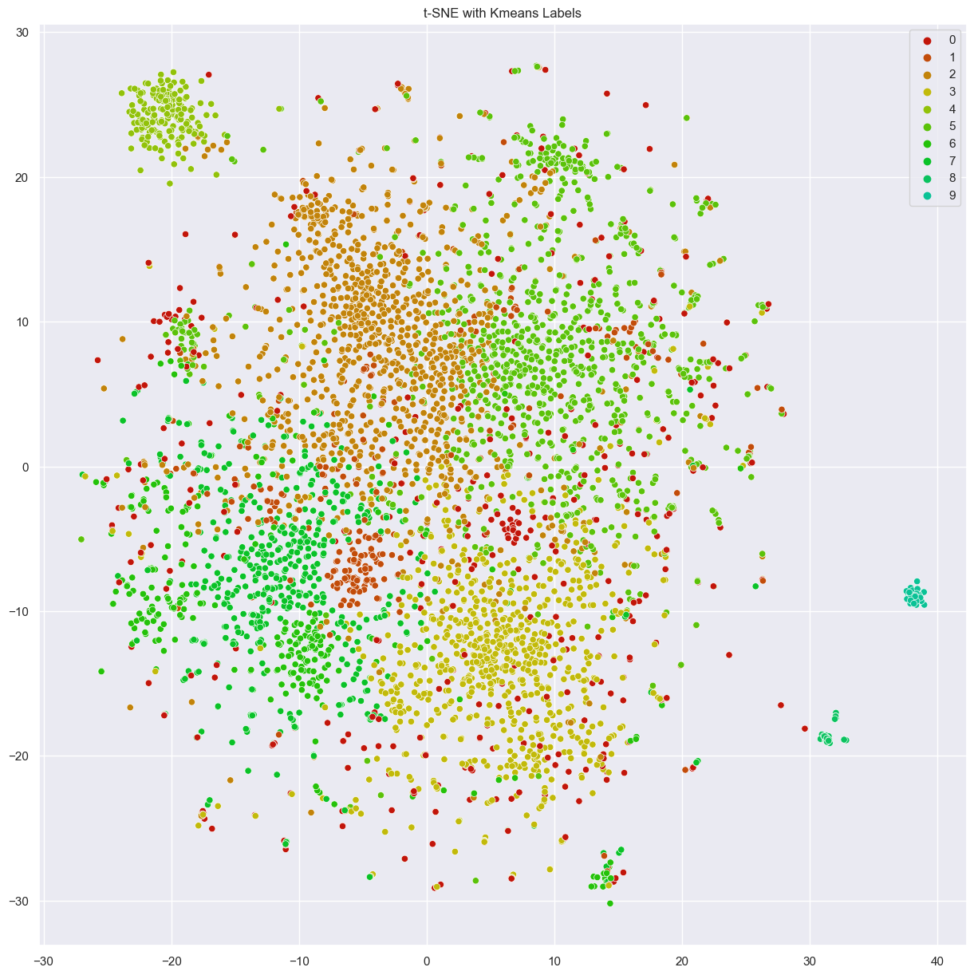
Each paper's position on the plot was selected by t-SNE, and the label's color by k-means.

Slide 27
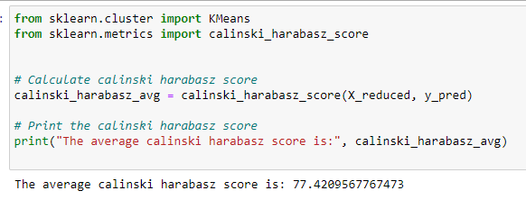
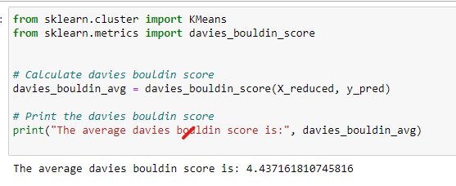
Evaluation of K mean clustering
N_clustering=10

Slide 28
Text Summarization
Implement a transformer based model for text summarization
A Transformer has two independent working parts: an encoder system that reads the input text and a decoder system that generates a job prediction.
Use T5 transformer model
An attention mechanism called a Transformer is one that recognizes the contextual relationships between words or subwords in a text.

Slide 29
T5 Model:
It is a pre-trained language model that can be fine-tuned for various natural language processing tasks, including text summarization
Advantages of T5 model
Pre-training on large text.
Fine-tuning for specific domains.
Ability to handle long and complex text.
High quality summaries.
T5 model approach has ability to improve to generalize to new and unseen data, which be helpful for generating accurate informative summaries of Covid19.
T5 model help health care professionals and researchers stay up to date with the latest information and make informed decisions in the fight against Covid-19.

Slide 30
Steps involved in building T5 Model:
Data Pre-Processing:
Loading the pretrained T5 model and will prepare the data for fine-tuning by formatting it into a suitable input - output format.
Use the t5 model which is trained to generate summaries.
Finally we will perform evaluation of the Model

Slide 31
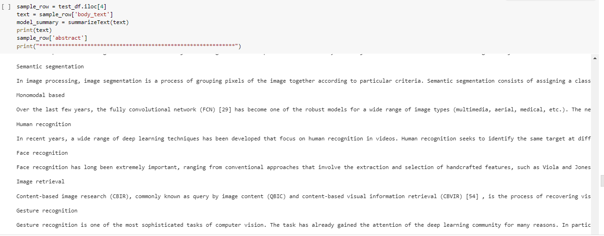
Sample Article

Slide 32
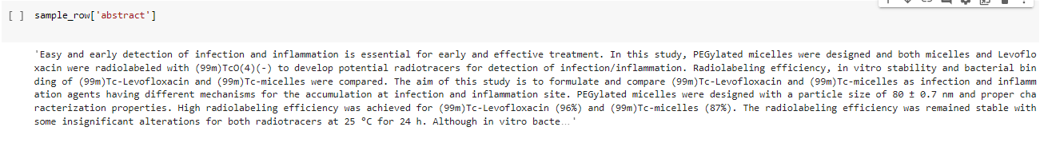
Sample Abstract

Slide 33
Model Summary

Slide 34
Rouge Score
 | Recall “r” | Precision ”p” | F1-measure “f”
rouge-1 | 0.21648618632622682 | 0.42651631752742314 | 0.2771151620143631
rouge-2 | 0.07870251141047911 | 0.16996098799181714 | 0.10172436659120346
rouge-L | 0.1993901719245532 | 0.39523014322525074 | 0.25588564601148533

Slide 35
References
https://www.jmlr.org/papers/volume21/19-763/19-763.pdf
https://allenai.org/data/cord-19
https://www.semanticscholar.org/paper/CORD-19%3A-The-Covid-19-Open-Research-Dataset-Wang-Lo/4a10dffca6dcce9c570cb75aa4d76522c34a2fd4
https://towardsdatascience.com/text-classification-in-python-dd95d264c802
https://www.altexsoft.com/blog/business/sentiment-analysis-types-tools-and-use-cases/
https://siddiquimubasheer.medium.com/text-summarization-using-bert-and-t5-e05dbbc757c6#:~:text=T5%20is%20one%20of%20the%20most%20qualified%20for,produce%20a%20short%20summary%20of%20a%20source%20text.
T5-Base Model for Summarization, Sentiment Classification, and Translation — Torchtext nightly documentation (pytorch.org)
https://medium.com/free-code-camp/what-is-rouge-and-how-it-works-for-evaluation-of-summaries-e059fb8ac840

